Slide 1
Basic principles of Doppler echocardiography
- Dr. Monisha Dsouza

Slide 2
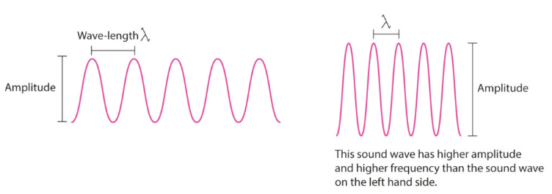
Properties of a sound wave

Slide 3
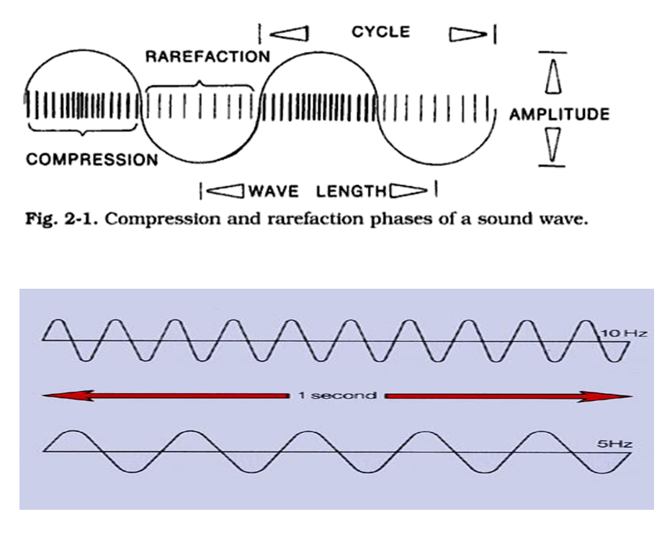

Slide 4
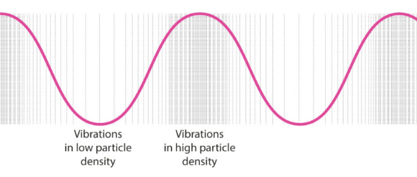
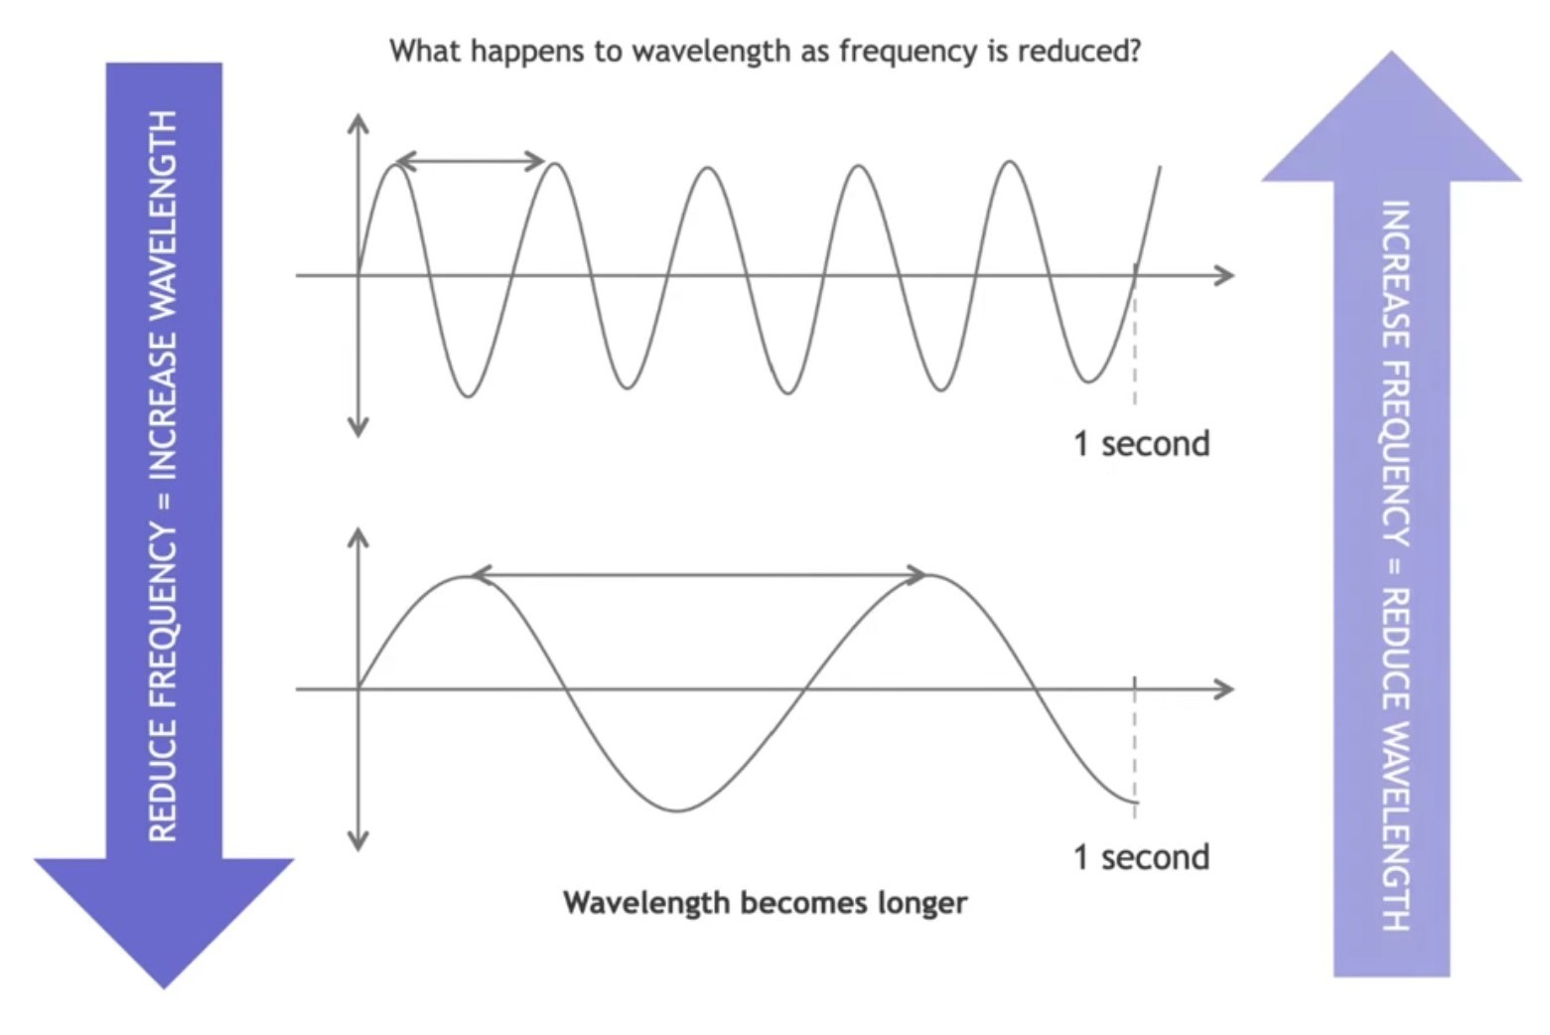

Slide 6
At interface: outcomes

Slide 7
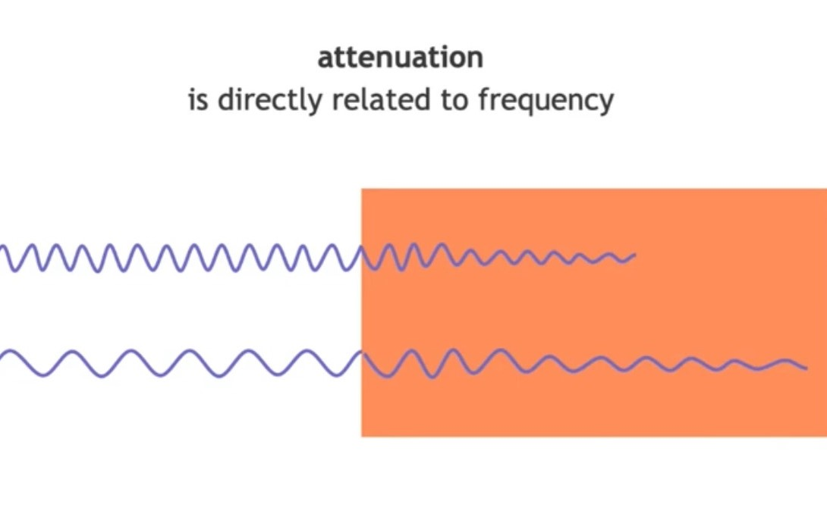
Attenuation:
Half power distance: distance travelled before amplitude is halved.
Rule of thumb: in body tissue (avg): attenuation: 0.5-1 dB/cm/ MHz.

Slide 8
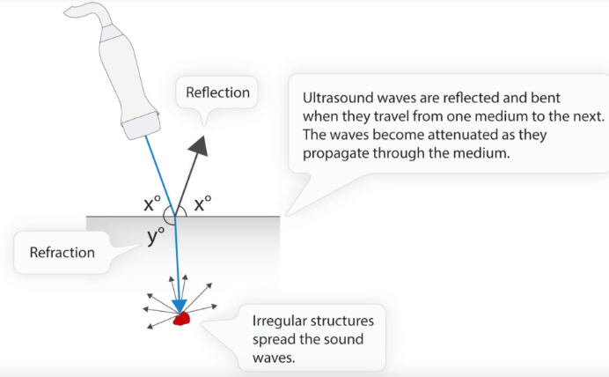
ACOUSTIC IMPEDENCE

Slide 9
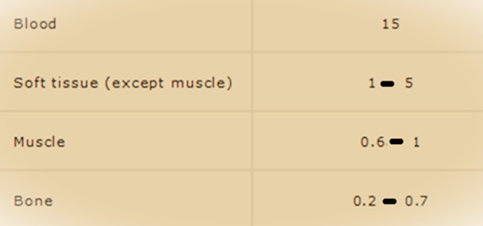

Slide 10
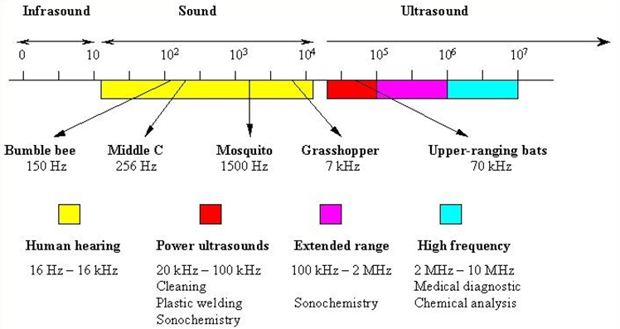
Principles of ultrasound:

Slide 12
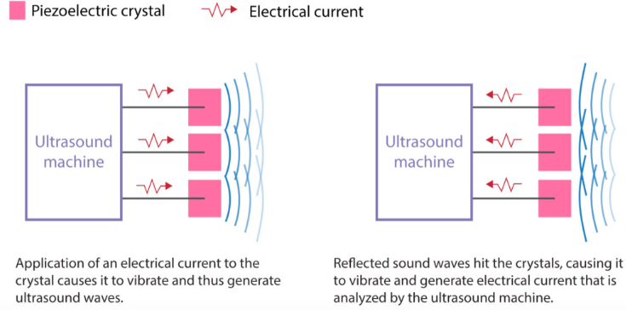

Slide 13
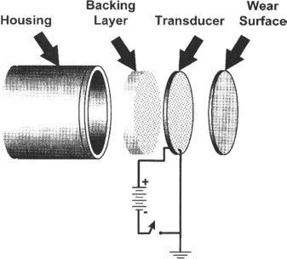

Slide 14
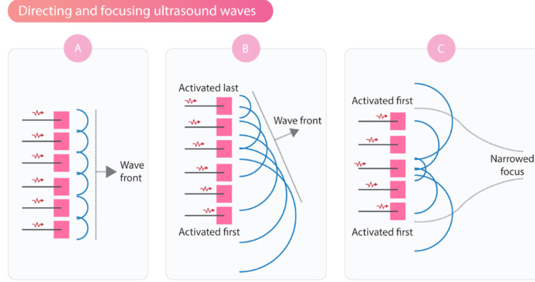

Slide 18
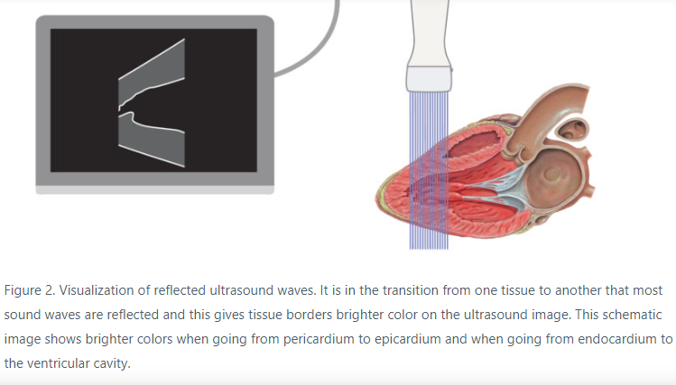

Slide 19
Imaging planes

Slide 20
Transducer movements:
Tilting
Angulation
Rocking
Sliding
Rotation

Slide 21
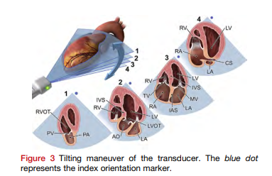

Slide 22
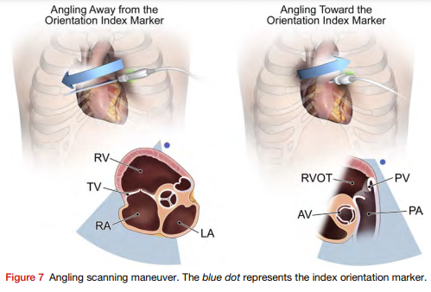

Slide 23
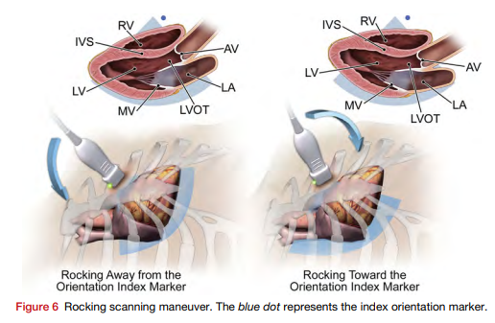

Slide 24
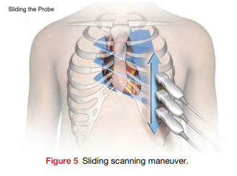

Slide 25
Instrument technicalities:
Power output: Adjusts the total ultrasound energy delivered by transducer; higher power: higher-amplitude.
Gain: Adjusts the graphically displayed amplitude: volume control in audio systems
TGC: Adjustment of gain along the length of the beam: compensate for attenuation.

Slide 26
Frequency inversely proportional to wavelenght
High-frequency probes have better near field resolution; lesser tissue penetration
Low-frequency probes have better tissue penetration but lesser image resolution

Slide 27
Depth: Affects the PRF and frame rate of the image.
Standard depth: entire plane.
Resolution/ zoom/ magnification: focus on a specific depth range of interest.

Slide 29
Dynamic range or compression: gray scale: number of levels of gray in the image:
marked contrast between light and dark areas
- gradation of gray levels between the lightest and darkest areas.

Slide 30
High-amplitude signals :bright white
Low-amplitude signals : dark gray
Absence of signal: black
To optimize the blood-tissue border (specular echoes) : based on body habitus
To demonstrate subtle differences in scattered echoes from weak reflectors [myocardium]

Slide 31
Too few shades of gray: under-representation or absence of subtle, low-amplitude structures.
Too many shades of gray: image appear ‘‘washed out” : removes accurate differentiation between the compacted and noncompacted myocardium.
Thin-walled segment
Thrombus
Vegetations

Slide 32
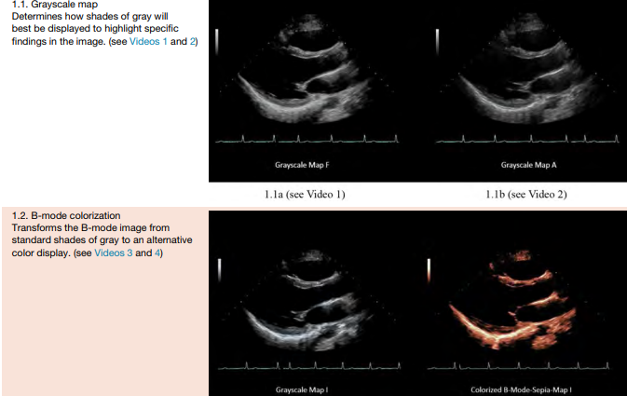

Slide 33
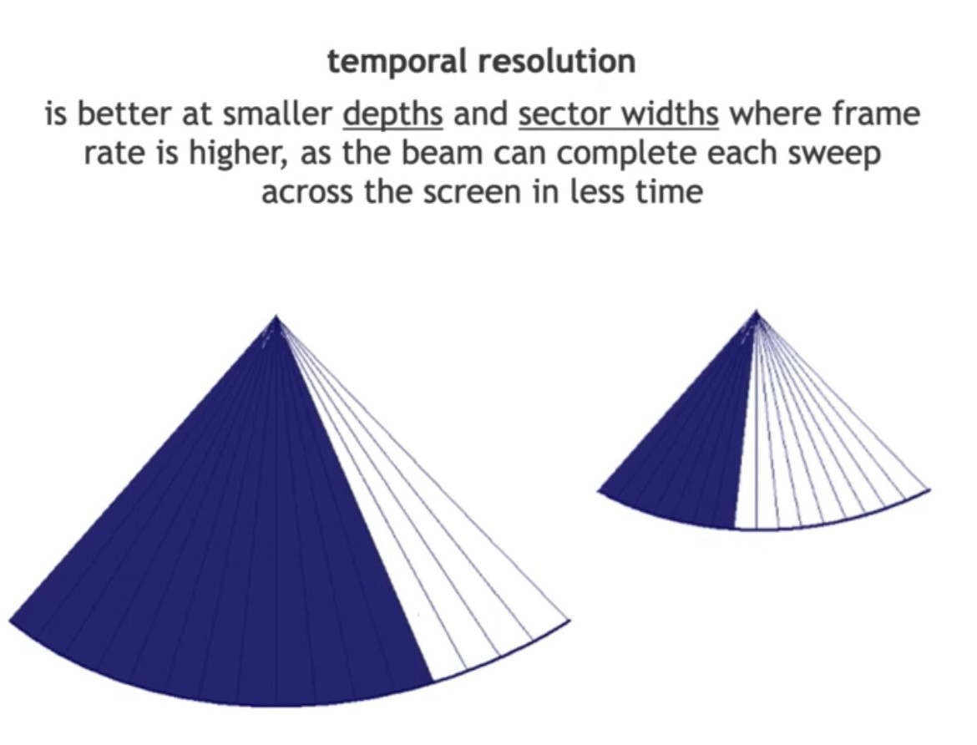
Resolution of image:

Slide 35
Christian Doppler:
Light from a star as observed from the Earth shifts:
-toward the red end of the spectrum (lower frequency or longer wavelength) if the Earth and star are moving away from each other
-toward the violet (higher frequency or shorter wavelength) if they are approaching each other.

Slide 36
Doppler echocardiography
Principle : Change in frequency of backscattered signal from small moving structures (e.g., red blood cells)
Doppler scattering from blood is similar to scattering of light in fog
[imaging is similar to reflection from mirror]
Stationary target [smaller than wavelength]: backscatter ultrasound : frequency same as transmitted.
Moving target: backscatter different frequency: DOPPLER SHIFT
Target moving towards transducer: higher frequency
Target moving away from transducer: lower frequency

Slide 37
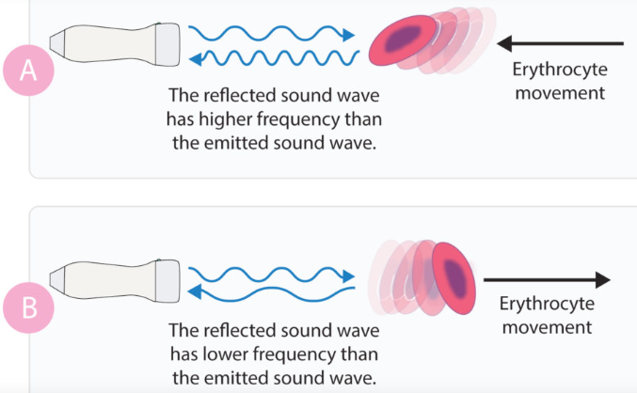
DOPPLER PRINCIPLE:

Slide 38
DOPPLER SHIFT:
Difference in frequency between transmitted (F[t]) and received wave (F[r])
(F[D]) = F[r] - F[t]
Doppler shift related to the velocity of the blood cells
Polarity of the shift related to the direction of blood flow:
Towards (positive shift)
Away (negative shift)

Slide 39
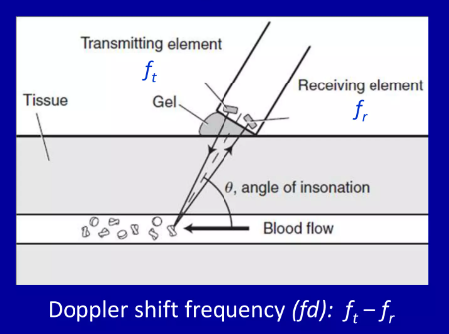

Slide 40
Blood flow velocity (V) is related to the Doppler shift using following parameters:
-Speed of sound in blood (C)
ø: intercept angle between ultrasound beam and blood flow.
Correction factor of 2 used: "round-trip" transit time to and from the transducer.

Slide 41
Doppler shift equation:

Slide 42
High-frequency probes are more sensitive to flow
Low-frequency probes are less sensitive to flow
Higher velocity of red blood cells : larger Doppler shift
Slow-moving red blood cells: smaller Doppler shift

Slide 43
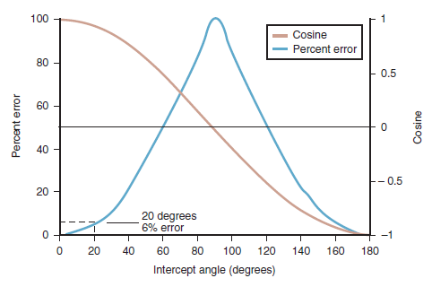

Slide 48
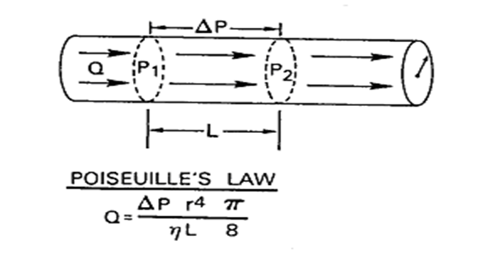
Bernoulli’s equation

Slide 49
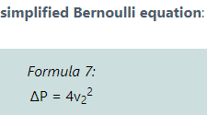
Bernoulli’s equation: flow dynamics:

Slide 50
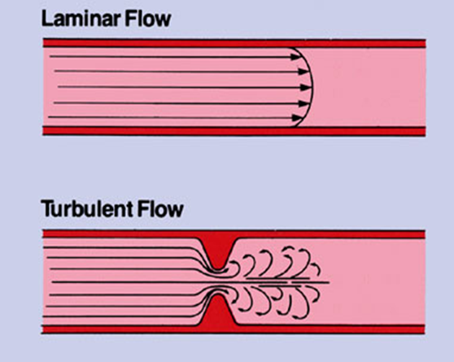
Blood flow:

Slide 51
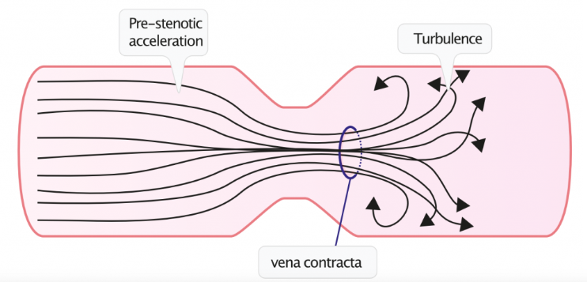
Continuity equation:

Slide 52
Doppler modes in Echocardiography:

Slide 53
Spectral Analysis
Difference between the transmitted and backscattered signals determined by “comparing” the waveforms.
Complex process: backscattered signal multiple frequencies [multiple RBC’s moving at different speeds]

Slide 54
Analysis:
Old: zero technique: ultrasound- sine wave- no. of times crosses zero.
Current: Fast Fourier Transform (FFT)
- Alternate method: analog Chirp-Z method.
Graphical Display of this analysis: spectral Doppler

Slide 55
Spectral Doppler
It provides graphical representation :
velocity :y-axis
Time: x-axis.
Each time point on the spectral display shows:
- Blood flow direction
- Velocity (or frequency shift)
- Signal amplitude

Slide 56
Pulsed-wave Doppler
Continuous wave Doppler
Blood flow towards probe: positive deflection
Blood flow away from probe: negative deflection
Spectral Doppler divided into:

Slide 57
Uses two ultrasound crystals;:
one continuously transmits
one continuously receives the signal.
Major advantage : very high-frequency shifts (velocities) can be measured accurately
Disadvantage: no range gating

Slide 58
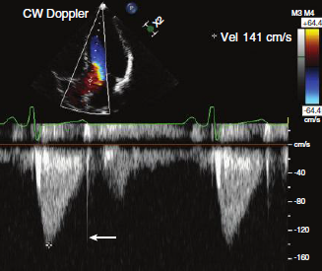
Simultaneous imaging transducer
Given signal: has characteristic shape, timing, and direction
CW Doppler velocity curve is “filled in” as lower-velocity signals proximal and distal to maximum velocity point also recorded.

Slide 59
Pulsed-wave (PW) Doppler
Pulsatile ultrasound waves
Specific location: Range Gating: sampling from specific intracardiac depth
Sends signal → pauses to receive reflected waves → Analysis (zero analysis: old; FFT: new)→ Graphical representation.
One Peizocrystal: transmitter and reciever: Sequential.
Principle: pulse repetition frequency (PRF).

Slide 60
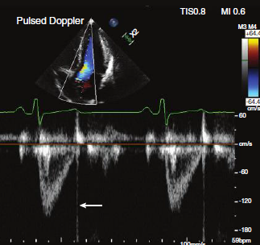
Pulse wave doppler:

Slide 61
Pulse repetition frequency
PRF is the number of ultrasound pulses emitted by the transducer over a designated period of time
Transmit-wait-receive interval.
Probe emits an ultrasonic wave and receives the reflected wave.
Two variables: transducer used, target dept.
Measured as pulses per second or hertz (Hz).
Typical range :1 and 10 kHz .
PRF = 1/ PRP (pulse repetition period: period between pulses)

Slide 62
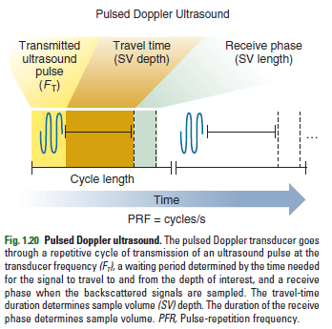
PRF:

Slide 63
Limited by:
Depth to be sampled (D)
Acoustic velocity of medium (c) .
PRF_{max}= c/2D
Depth of sample desired (D) = 0.5 x (c/PRF)

Slide 64
Nyquist limit
Maximum limit of velocity/ frequency shift that can detectable by PW doppler unambiguously
Optimized: higher PRF (faster moving flows)
Nyquist limit= PRF/2
PW Doppler:
-Disadvantage: If Nyquist limit exceeded: Aliasing.
-Advantage: Range gating.

Slide 65
Aliasing:
Repeat “wraparound” of the signal occurs:
-First into the reverse channel
-Back to the forward channel

Slide 66
Aliasing
Phenomenon of ambiguity in the speed, direction, or both : of sampled signal
For frequency to be correctly identified, it must be sampled at least twice per wavelength.
Thus the maximum detectable frequency shift (Nyquist limit) is one-half the PRF.

Slide 68
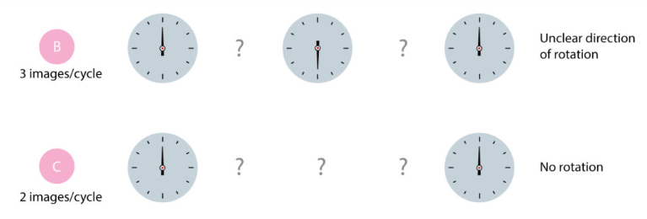

Slide 70
Methods to resolve aliasing :
- Using CW Doppler ultrasound
Increasing the PRF to the maximum for that depth (the Nyquist limit)
Higher PRF Doppler.
- Using lower-frequency transducer
- Shifting baseline to the edge of the display

Slide 71
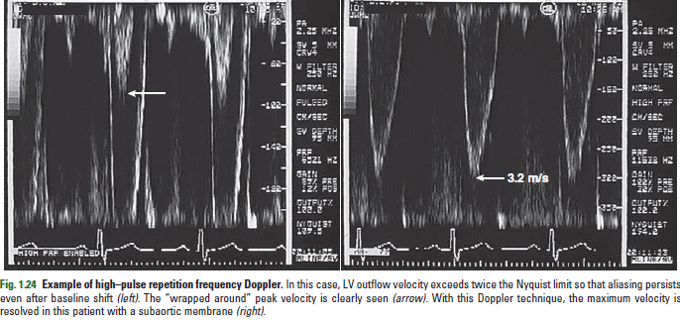

Slide 72
Colour Doppler:

Slide 73
Diagnostic goal:
optimize display
recognition of abnormal flow patterns.
Color flow map depends on:
- Color scale (assignment of colors to direction and velocity)
- Velocity range (within the Nyquist limit at that depth)
- Zero baseline position on the color scale
- Addition of variance to the color scale
Specific color scale: personal preference

Slide 74
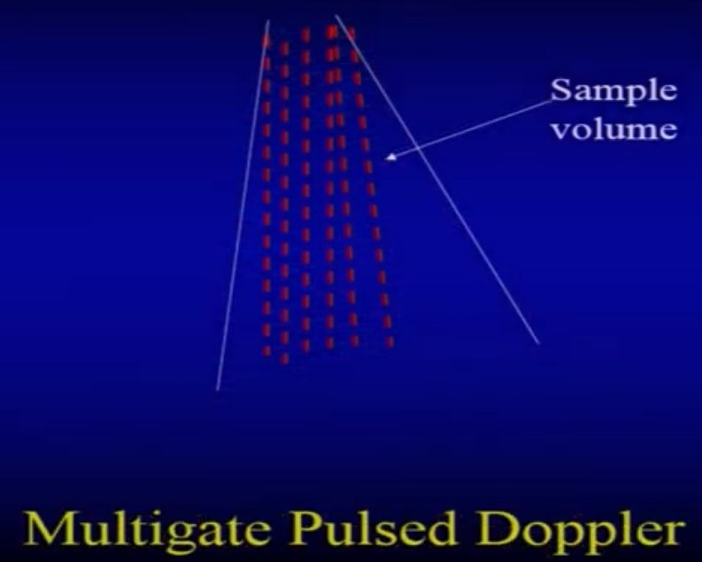

Slide 75
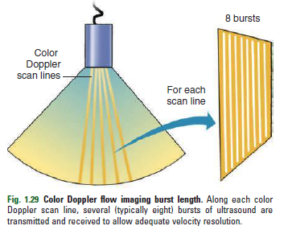

Slide 78
The Doppler principle used to measure motion of the myocardium
Either pulsed Doppler or color Doppler
The basic principles of Doppler ultrasound apply to tissue Doppler.
Tissue Doppler signals very high amplitude: power output and gain settings are low.
Doppler velocities are low: velocity range is small.

Slide 79
Summary:

Slide 80
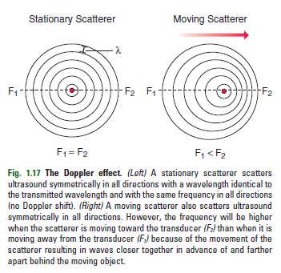

Slide 85
Thank You

